Slide 1
Suprema Unity Integration
George Cartlidge – 2nd Line Technical Support/Developer

Slide 2
Contents
Installation and setup
General Usage

Slide 3
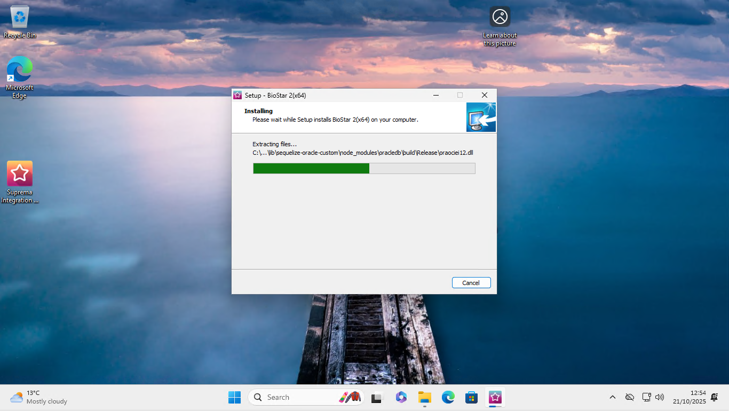
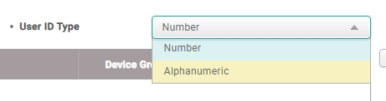
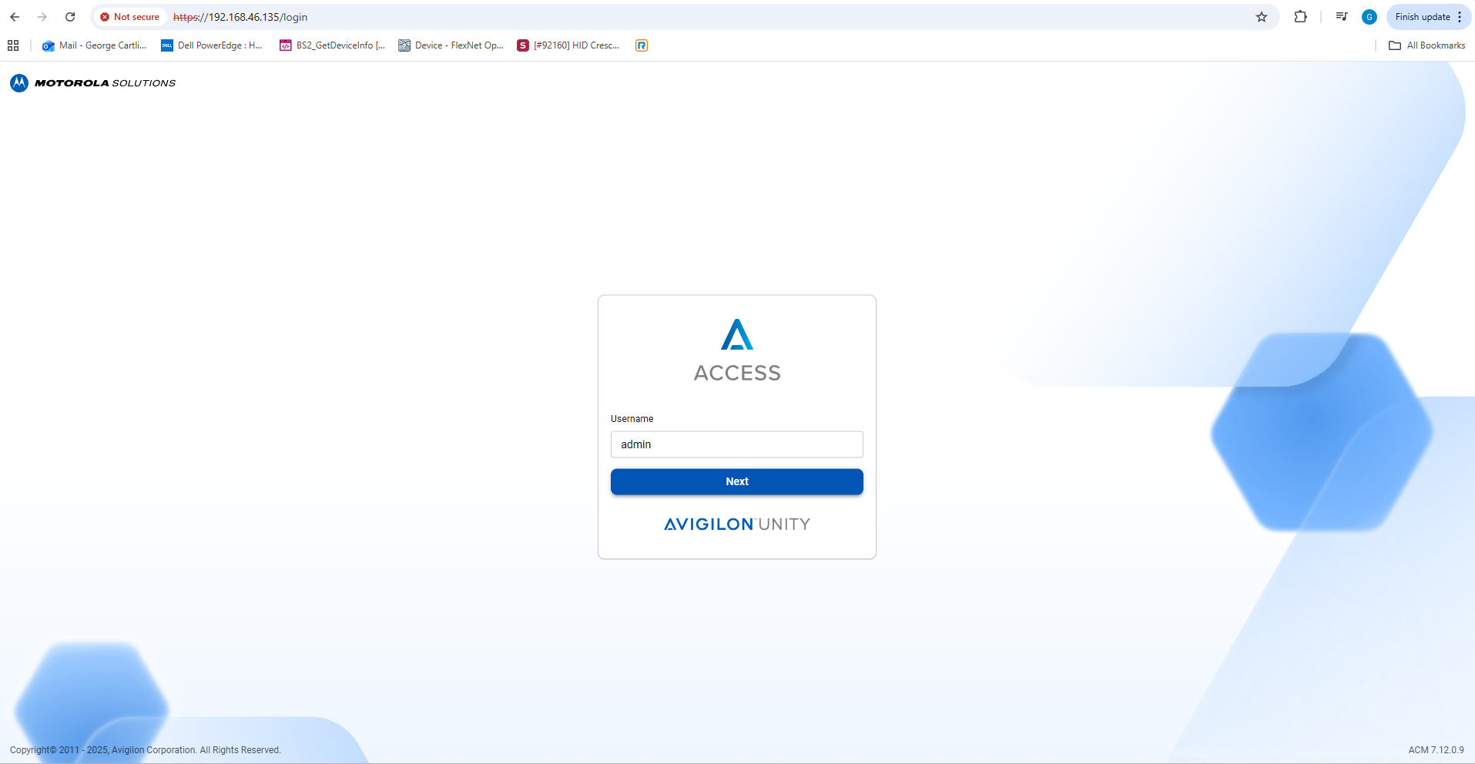
Installation & Setup
1. Installation & Setup l 2. General Usage l 3. Future/Feature Requests
The integration is based upon the BioStar 2 backend, using APIs to get information from an
Avigilon Unity installation, then uploading this to BioStar 2 (We are currently in the process of
releasing BioStar X, this will also be supported as many of our APIs are staying the same)
BioStar 2 installation as standard on a separate Windows 11 virtual machine. NOTE: BioStar 2 will have to be set as Alphanumeric, as the GUID from Unity is used as ID.
For the Avigilon Unity setup, for the test environment, I am running the HyperV Virtual machine image, on IP https://192.168.46.135, with one EP1501 board connected.

Slide 4
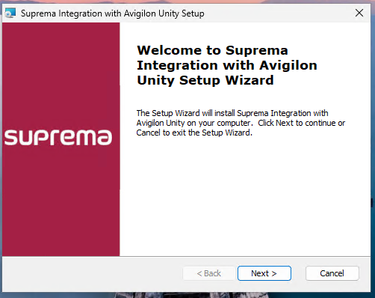
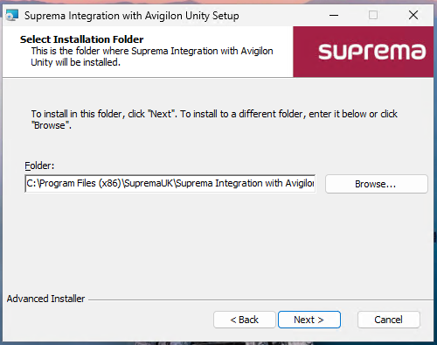
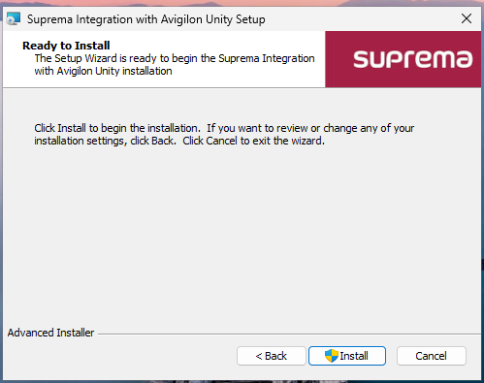
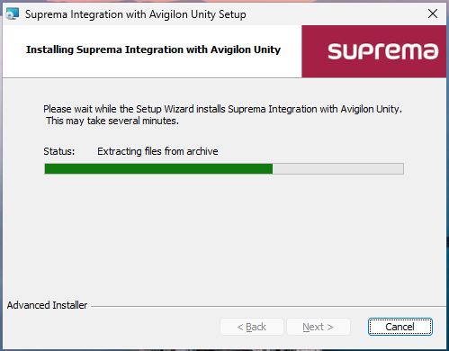
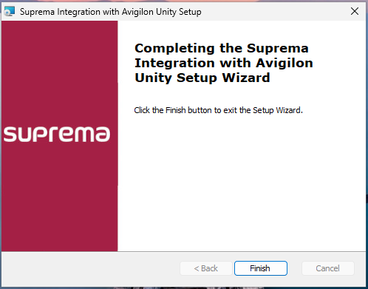
Installation & Setup
1. Installation & Setup l 2. General Usage l 3. Future/Feature Requests
The installation of the integration is quite simplistic; this just needs to be installed on the same server that BioStar 2 is installed on.

Slide 5
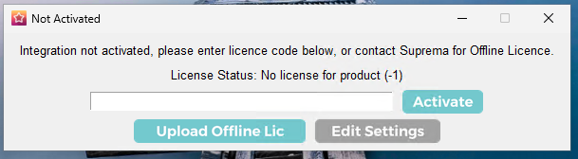
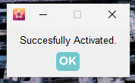
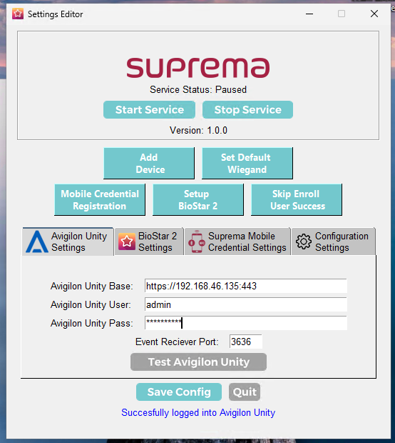
Installation & Setup
1. Installation & Setup l 2. General Usage l 3. Future/Feature Requests
Once installed, a shortcut will be placed on the desktop. This is the settings editor and will allow you to enter specifics for the installation. On first run, the integration will need to be activated.
The first screen is the connection details for the Unity installation, you will need the IP address and port.
There is also the event receiver port selection, this is used for automatic sync and is setup within collaborations in Unity.
Enter the settings and press Test!

Slide 6
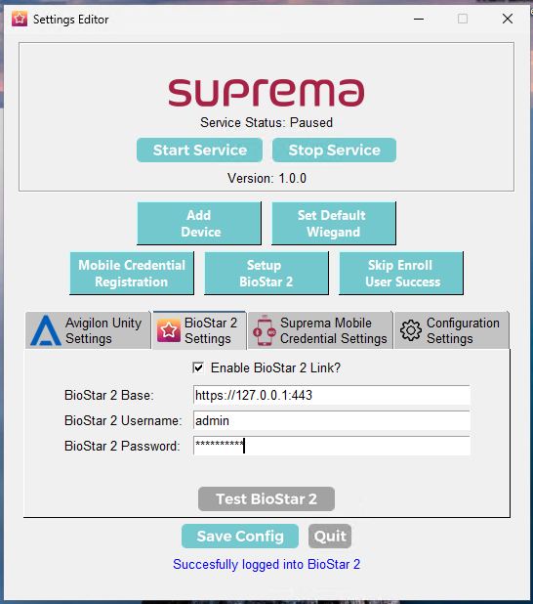
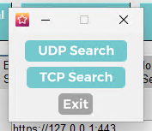
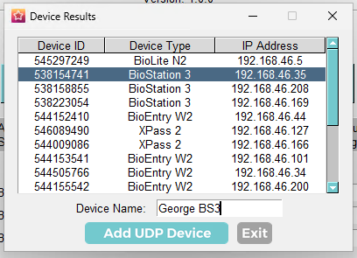

Installation & Setup
1. Installation & Setup l 2. General Usage l 3. Future/Feature Requests
The next section is the connection to BioStar 2, as this is installed on the same machine as the integration, we can use the 127.0.0.1 address, once connected, you will be able to use the buttons on the upper section (Add device, Set Default Wiegand, Setup BioStar 2 etc)
The ‘Set Default Wiegand’ option will set Avigilons 56 bit setting into BioStar 2, as well as automatically apply that to any connected BioStar 2 device.

Slide 7
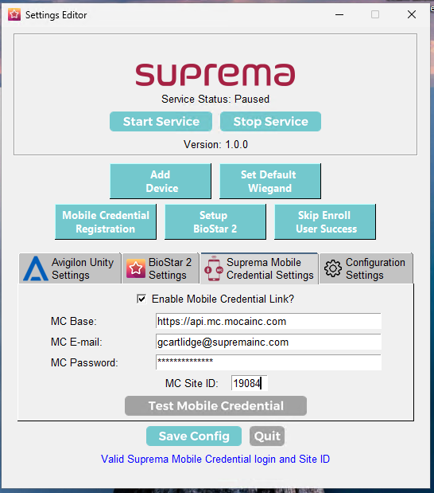
Installation & Setup
1. Installation & Setup l 2. General Usage l 3. Future/Feature Requests
The next section is the connection to the Suprema Mobile Credential. As long as the user within Avigilon has both an email address and token applied, that token will be uploaded to the Suprema Mobile Credential portal. To use this section (Both BioStar 2 and Mobile Credential can be enabled separately) you will need to create a site at https://portal.airfob.com

Slide 8
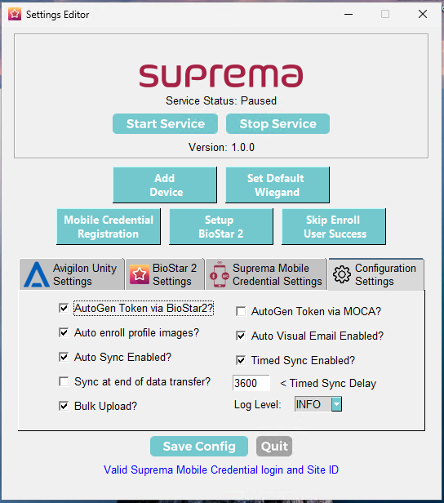
Installation & Setup
1. Installation & Setup l 2. General Usage l 3. Future/Feature Requests
The final section is where you will activate/deactivate certain settings within the integration.
AutoGen Token via BioStar 2 will automatically generate a random token within Avigilon unity if the user does not have one already. (Specifically checking BioStar 2 if token already exists)
AutoGen Token via MOCA will automatically generate a random token within Avigilon unity if the user does not have one already. This specifically checks MOCA if the random token already exists
Auto Enroll Profile Images will take the user image from Unity and enroll it to user as face credential (If valid)
With Auto Visual Email enabled, the integration will send a visual enrollment email to any new user added from Unity.
Auto Sync Enabled controls whether the event receiver port is active. This allows events from Unity to start the sync
Timed sync can be used to periodically sync the system, the setting below is the time in seconds that the integration will wait before doing the next sync (Default every hour)
Sync at end of data transfer will automatically sync the devices in BioStar 2 via API at end of sync (Only needed for V1 devices)
Log level can be set as either INFO or DEBUG, this can be helpful when looking into the logs kept within the program files folder.
Bulk Upload will use the Bulk Upload feature of BioStar 2 (Version 2.9.10 onwards) that can significantly reduce sync time.

Slide 9
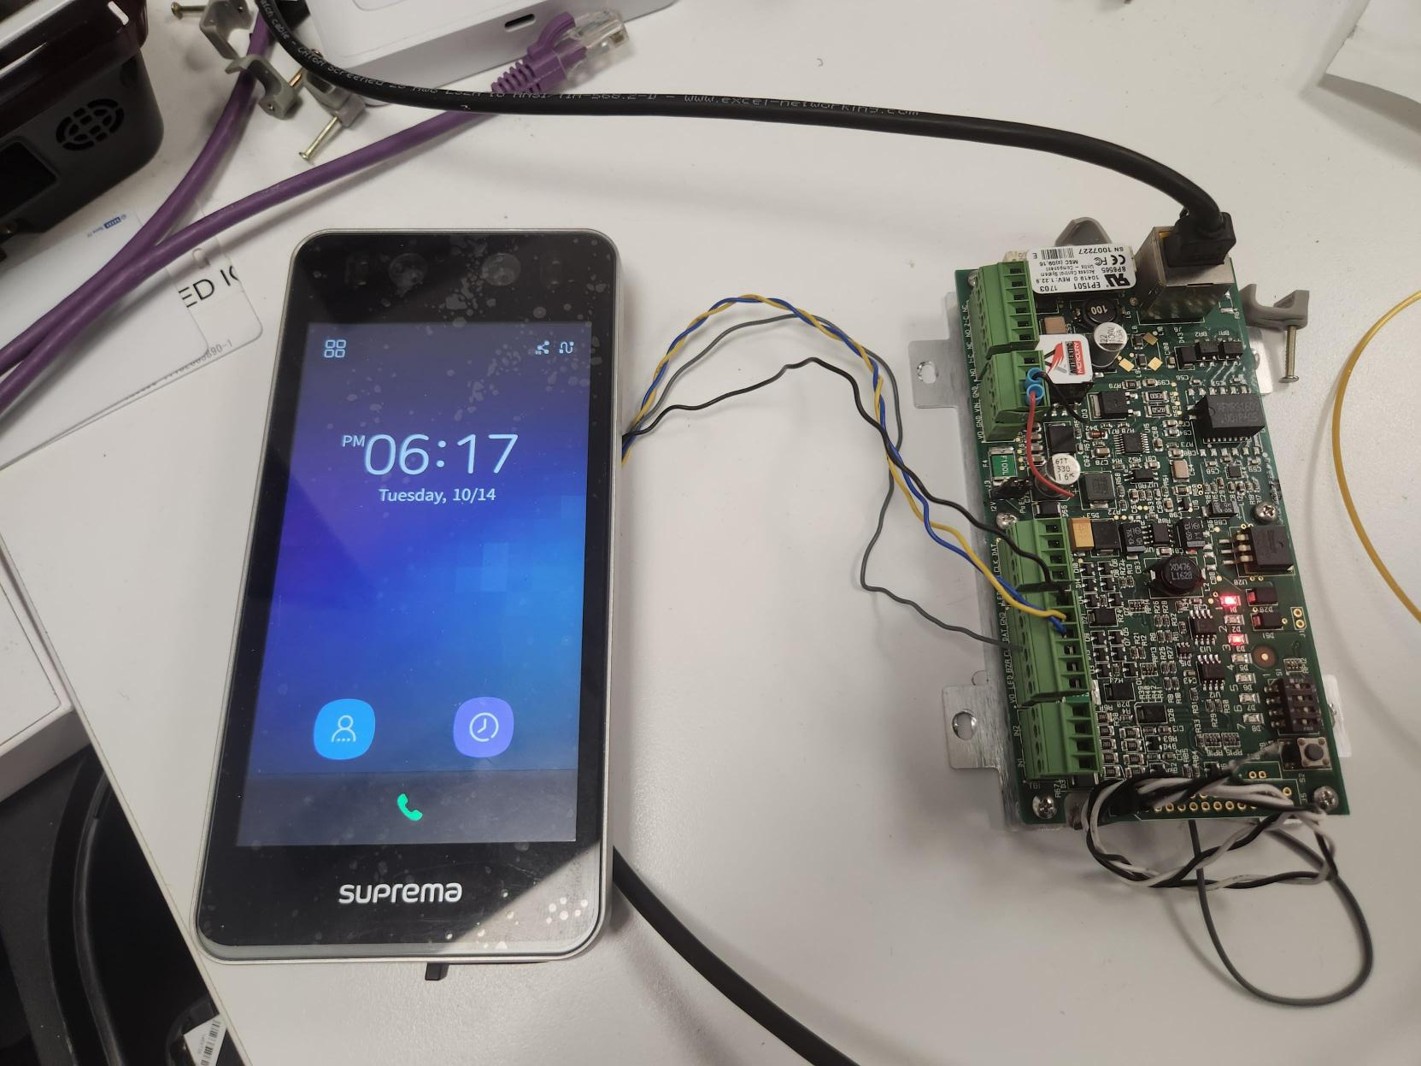
Installation & Setup
1. Installation & Setup l 2. General Usage l 3. Future/Feature Requests
For device connection to the access control board, both OSDP and Wiegand are supported, if using OSDP, the Baud rate will need to be matched on both devices (ACU and Suprema). While testing, I have focused on OSDP as that will be the most desirable.
Above I have just used the default 9600 from the mercury board.
The wiring to Mercury board is just standard TX+ RX- and GND. When successfully connected, you will see the RS icon on the top right of the device (If has LCD).
Both devices here are being powered by POE, so wiring is very easy!

Slide 10
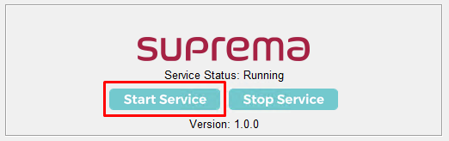
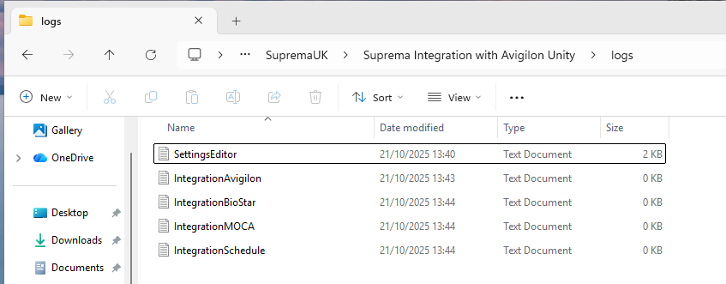
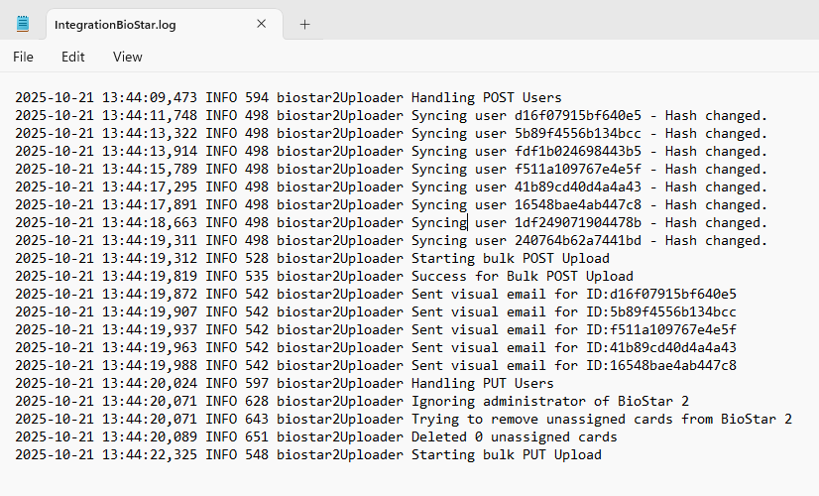
General Usage
1. Installation & Setup l 2. General Usage l 3. Future/Feature Requests
Once settings are entered, you can press ‘Start Service’ to kick off the background service that syncs both systems.
Once started, you can keep an eye on what is happening with the sync by using the log files (Normally in logs folder within program files)
You can see from the log above, we had a successful sync of 8 users from Avigilon Unity, within sync logic, there is also hash checking, so the integration will not needlessly upload users if the information uploaded to BioStar 2 previously has not changed)

Slide 11
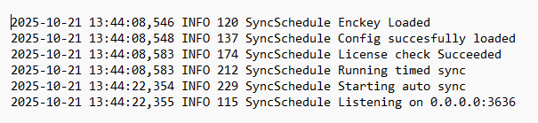
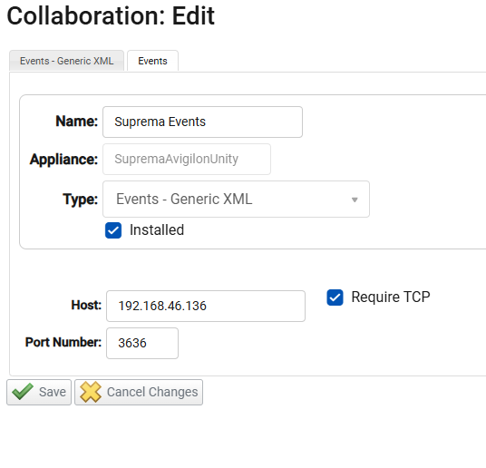
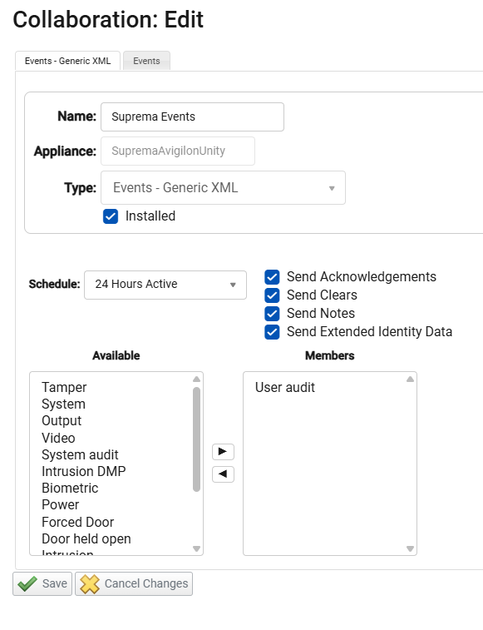
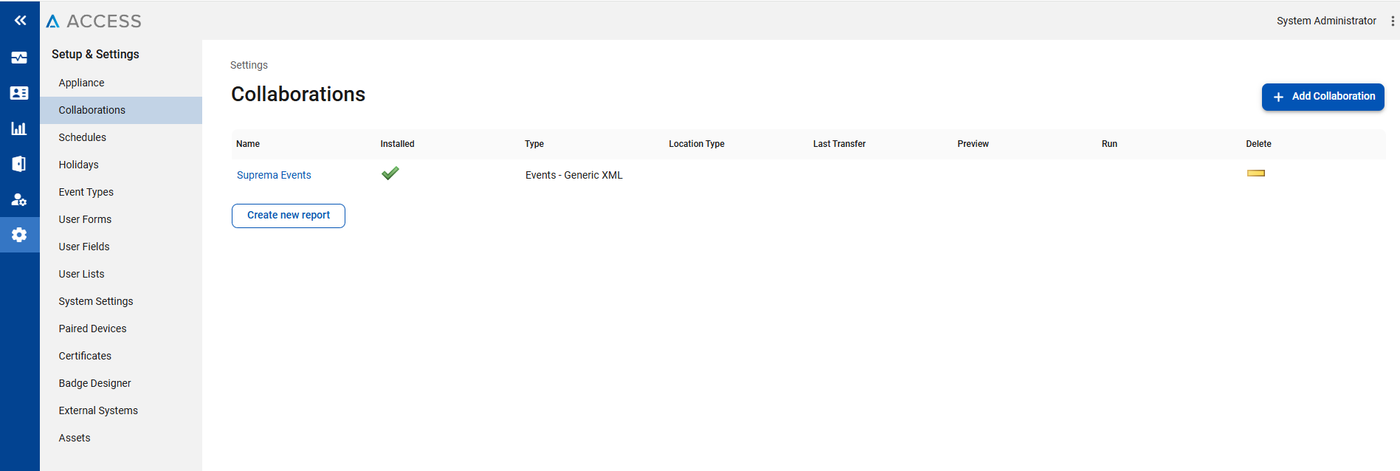
General Usage
1. Installation & Setup l 2. General Usage l 3. Future/Feature Requests
For auto sync to work, you will need to setup the required settings within Unity, the default listener port within integration is 3636 (But can be changed if needed), within Unity, this is under the collaborations section.
For the collaboration section, you will need the IP address of the server running the integration (You may need to change rule within firewall if using other port), Require TCP also needs to be enabled.
The two screenshots here detail all the sections that need to be active, the listener will only need the User Audit member.
Once connected, you will see a log that there is a connection from the Unity machine IP address.

Slide 12
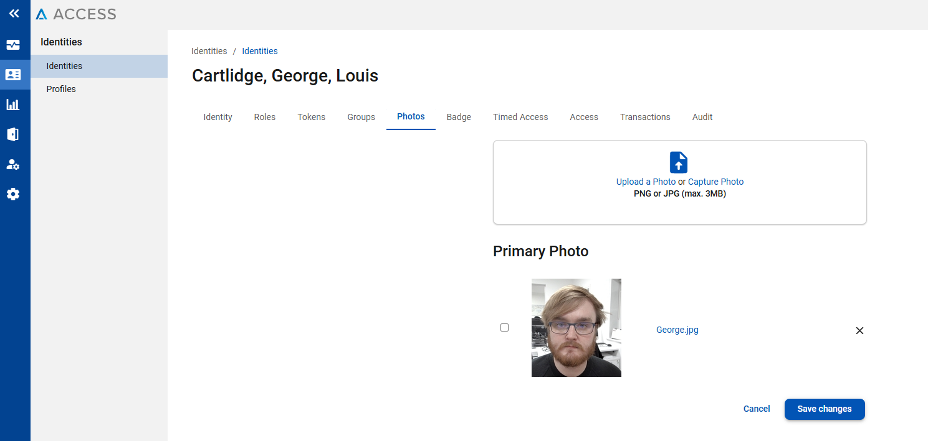
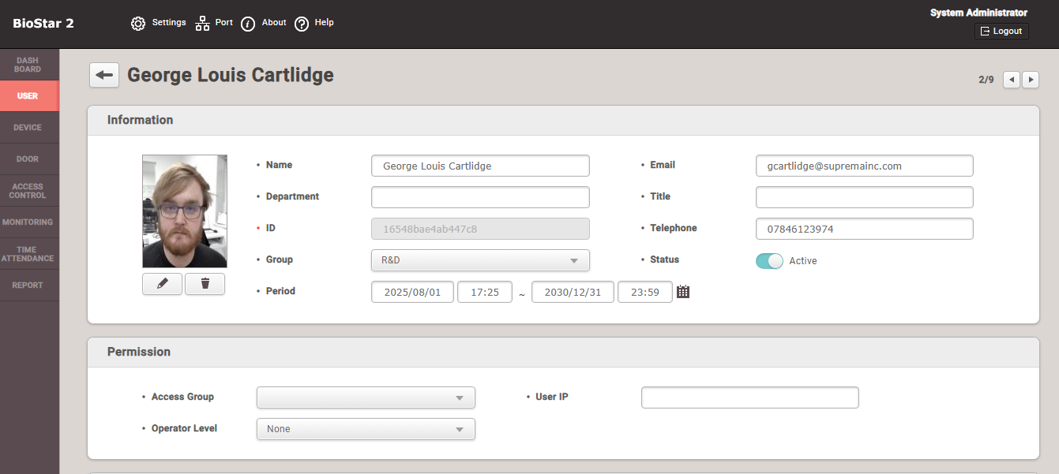
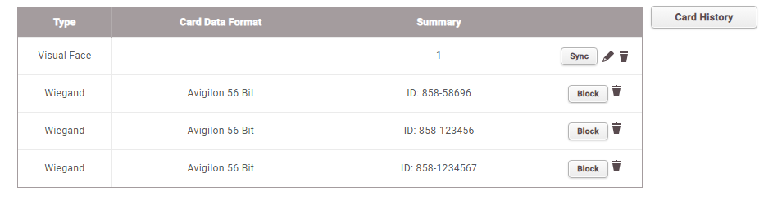
General Usage
1. Installation & Setup l 2. General Usage l 3. Future/Feature Requests
Now, once that is all setup, for facial recognition, you can simply use Avigilon Unity as normal, whenever a user is created, this will automatically sync to BioStar 2 and if an image is uploaded to user, the visual face will be extracted, All cards registered to the user will also be uploaded.
The log above is the automatic sync from myself adding a photo to my user.
Manual face scans can also be taken from BioStar 2

Slide 13

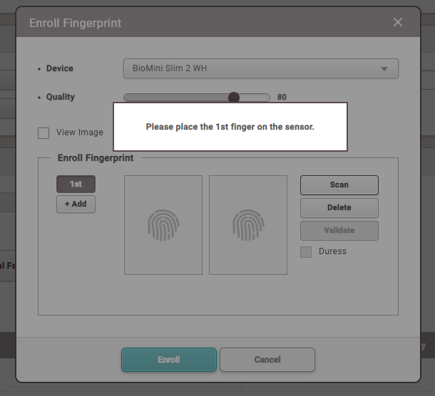
General Usage
1. Installation & Setup l 2. General Usage l 3. Future/Feature Requests
For fingerprints, currently, you will have to take the enrolment from BioStar 2
This is just under each user (Which will be uploaded automatically to BioStar 2) on the
button.

